Slide 1
CSE400 : Fundamentals of Probability in Computing
Group - 6
Section - 1
Members:
  Manas Pandya
  Dhruvil Joshi
  Prince Vegad
  Samridhi Mehrotra
  Manya Chudasma

Slide 2

Probabilistic Route Selection for On‐Time Arrival
Motivation: commuters and intelligent transportation system require routes
that maximize the probability of arriving beforea deadline under uncertain traffic.
Deterministic shortest-paths can be suboptimal when travel times are stochastic.

Slide 3
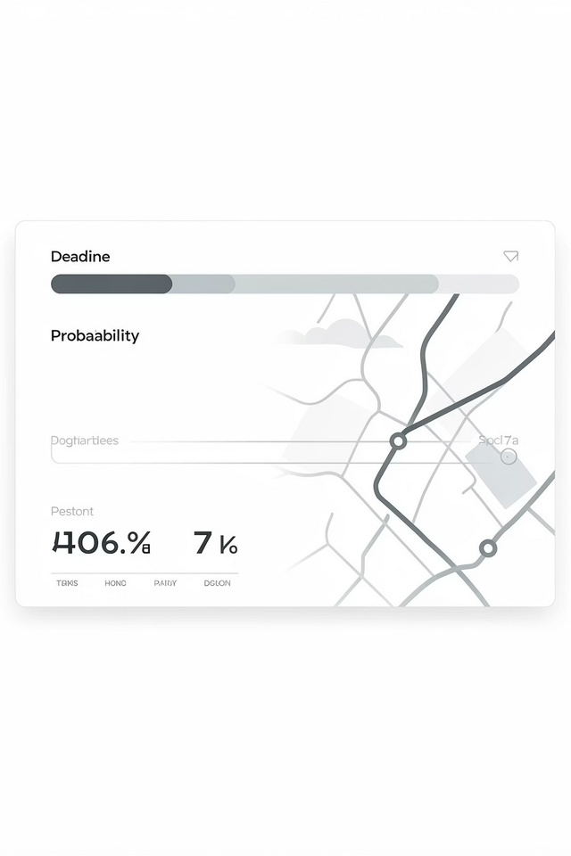
Objective & Core Probability
Objective: maximize P(T_route ≤ D),the probability thattotalroute travel time
T_route is less than orequalto deadline D. Decision rule:choose the route with the highest reliability, not necessarily the lowest expected time.

Slide 4




End-to-End System Pipeline
Traffic Simulation
Generate realistic vehicle trajectories and travel time samples using SUMO and
calibrated
scenarios.
Data Extraction
Distribution Modeling
Reliability Estimation
sampling and analytical bounds produce P(T_route ≤ D) for candidate
routes.
Extractlink-level travel times and timestamps from simulation logs for statistical
modeling.
Fitper-segment PDFs/CDFs (e.g., lognormal), then aggregate to obtain route distributions.
MonteCarlo

Slide 5

Sources of Uncertainty
Measurement noise: simulation seeds, sampling variability, sensor error
Environmental variability: changing
demand, incidents, weather effects
Microscale interactions: queue
dynamics, vehicle interactions, gap
acceptance
Modeling error: distributional
assumptions, independence
approximations

Slide 6
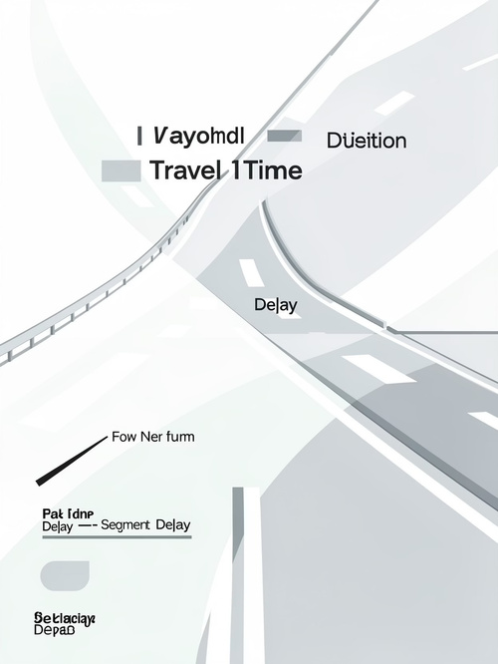
Key Random Variables
Ti = travel time random variable for segment i (stochastic, positive support). T_route = Σ_{i=1}^n Ti — sum of segment travel times; distribution depends on
marginal PDFs and cross-segment dependence.
A = T_route − D. On-time if A ≤ 0; lateness risk when A > 0.

Slide 7
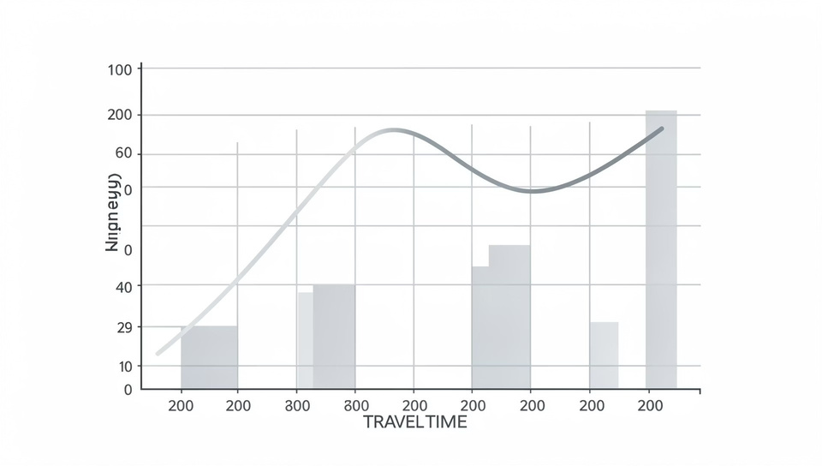
Probabilistic Model Choice & Assumptions
Model: Ti ~ Lognormal(μi, σi^2) — chosen for positive support and right skew consistent with travel-time observations.
Assumptions: (1) segment independence
(simplifies aggregation), (2) quasi‑static
traffic conditions during planning horizon,
(3) stationarity of fitted parameters within
scenario. Practical note: assumptions ease
computation but require validation against
data; violations increase estimation error.

Slide 8
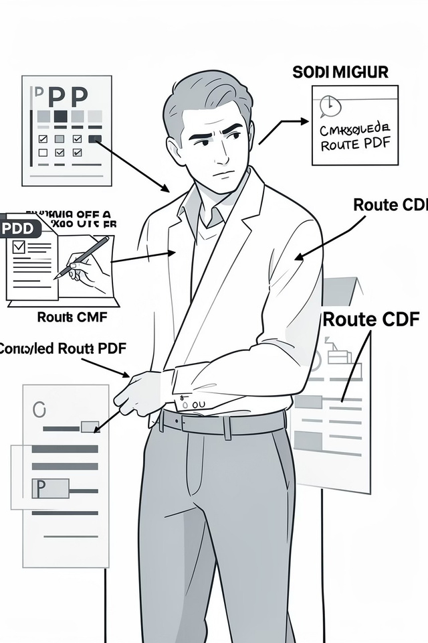
From PDFs to Reliability — Visual Evidence
Interpretation: segment-level skewpropagatestoroute-leveldispersion;
evaluateCDF atD to obtain reliability.Visualdiagnosticsconfirmmodel fit and quantify early vs late risk.

Slide 9
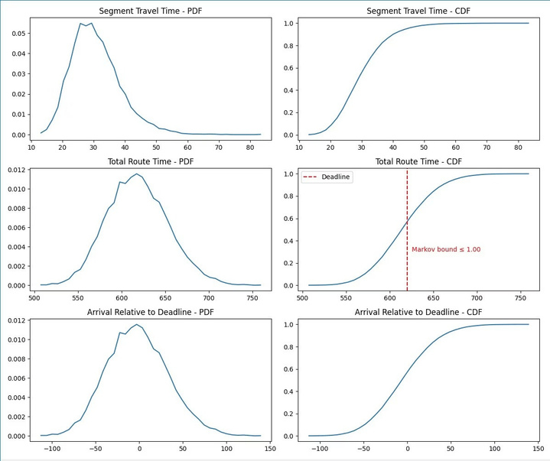
Probabilistic Reasoning & Evidence
Segmenttravel time PDFs confirm stochastic delays
Total route time distribution shows uncertainty propagation CDF evaluated at deadline gives reliability Arrival-relative distribution highlights early vs late risk Simulation results from SUMO capture realistic stochastic
travel time variability.
PDF highlights variability and skewness in travel times
across segments.
CDF directly quantifies probability of meeting the arrival
deadline.
Supports reliability-based routing instead of shortest-path
decisions.

Slide 10
Operational Implementation
Simulate
Fit
Evaluate
Implementation steps: calibrated SUMO runs → Monte Carlo sampling → estimate PDFs/CDFs → compute reliability metric →
rank candidate routes.
Metric: Reliability = P(T_route ≤ D).
Simplifications currently: no segment
correlation, static deadlines, conservative
analytical bounds for safety.
Run calibrated stochastic SUMO
Estimate per‑segment distributions
Compute P(T_route ≤ D) and
rank
Aggregate
Sample
MonteCarlo or
Extracttraveltime
analytic
samples
convolution

Slide 11

Limitations & Validation Needs
Independence
Segment independence may be violated; correlated delays (spillback) can bias reliability estimates.
Distribution Fit
Lognormal is a pragmatic choice but requires goodness-of-fit testing across regimes and times
of day.
Analytical Bounds
Conservative bounds provide safety but can be overly pessimistic for decision-making.
Operational Gaps
No adaptive rerouting or real-time Bayesian updates yet; latency and computational cost matter
for deployment.

Slide 12

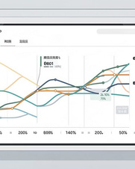
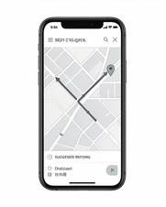

Planned Refinements & Next Steps
Correlation Modeling
Incorporate inter-segment correlation via copulas or multivariate distributions to better capture spillback effects.
Bayesian Updating
Dynamic Rerouting
Design low-latency rerouting policies that trade off travel- time expectation and reliability under updated forecasts.
Evaluation & Reproducibility
Tighten validation: cross‑validation of fits, A/B tests in simulation, publish code and datasets on GitHub for reproducibility.
Fuselivesensordatato update distribution parameters and reduce uncertainty during the trip.
Final takeaways: travel times are stochastic — use PDFs/CDFs and Monte Carlo plus improved correlation models and online updates to enable robust, risk‑aware routing decisions.

